Slide 1
Chapter 10
Introduction to Time Series Modeling and Forecasting

Slide 2
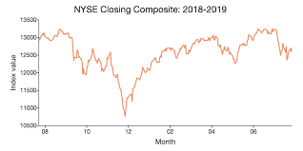
A time series is a collection of data obtained by observing a response variable at periodic points in time (usually at equal intervals)

Slide 3
COVID-19 cases in the United States by date of illness onset, January 12, 2020, to April 9, 2020, at 4pm ET (n=254,596)
Date of illness onset

Slide 4
The secular trend of a time series is the tendency of the series to increase or decrease over a long period of time. Also known as the long-term trend.
The cyclical fluctuation (Ct ) of a time series is the wavelike or oscillating pattern about the secular trend that is attributable to business and economic conditions at the time. It is also known as a business cycle.
The seasonal variation (St ) of a time series describes the fluctuations that recur during specific portions of the year (e.g., monthly or seasonally).
The residual effect (Rt ) of a time series is what remains after the secular, cyclical, and seasonal components have been removed.
Additive Model: y_{t} = T_{t} + C_{t} + S_{t} + R_{t}

Slide 5
In many practical applications of time series, the objective is to forecast (predict)
some future value or values of the series.
See Step 5

Slide 6
Impact of Autocorrelation

Slide 7
Dealing with Autocorrelation
Find and include the missing variable(s)
Use weighted (generalized) least squares
Use a model that incorporates the autocorrelation and estimate the parameters in that model

Slide 8
Detecting Autocorrelation
If X and Y or X and Y then X and Y are positively correlated.

Slide 9
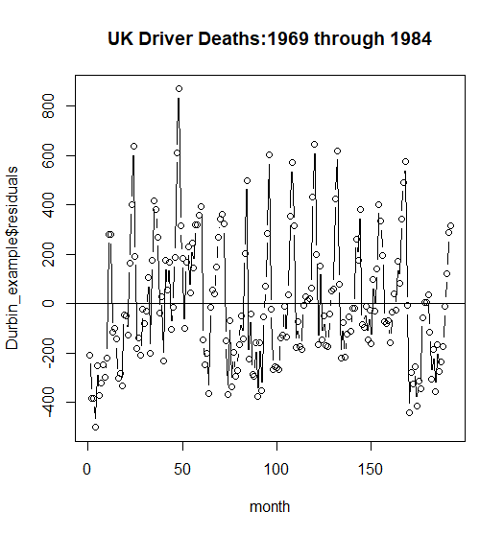
Detecting Autocorrelation
Fit UK Driver Deaths versus month
y= B0 + B1 (month) + error
Plot of residuals versus time (note if the residual for month t is positive then the residual for month (t+1) is positive
Durbin-Watson d statistic

Slide 10
Detecting Autocorrelation
H0: No residual correlation
H1: (positive residual correlation) or
H1: (positive or negative residual correlation) or
H1: (negative residual correlation
The Durbin-Watson test assumes if there is autocorrelation then the model errors are generated from a first-order autoregressive process.
From R output for UK Driver Deaths
dwtest(Durbin_example, order.by = NULL, alternative = c("two.sided"),
exact = NULL, tol = 1e-10)
Durbin-Watson test
data: Durbin_example
DW = 0.72733, p-value < 2.2e-16
alternative hypothesis: true autocorrelation is not 0

Slide 11
R program for Durbin Watson
library(faraway)
library(lmtest)
library(timeSeries)
windows(7,7)
#####
plot(UKDriverDeaths)
Durbin_example_data <- data.frame(UKDriverDeaths)
month <- seq(1, 192, by=1)
Durbin_example_data <- data.frame(cbind(month,Durbin_example_data))
Durbin_example <- lm(UKDriverDeaths ~ month,data=UKDriverDeaths)
names(Durbin_example)
plot(x=month,y=Durbin_example$residuals,type="b",main="UK Driver Deaths:1969 through 1984")
abline(h=0)
dwtest(Durbin_example, order.by = NULL, alternative = c("two.sided"), exact = NULL, tol = 1e-10)

Slide 13
All observations are used

Slide 14
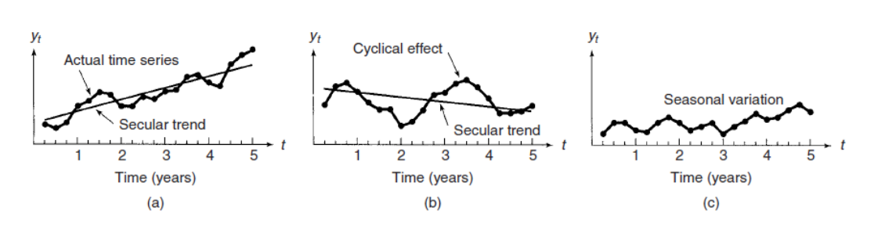

See Exercise 10.6 in textbook
Also see Exercise10_6_Answer.pdf in Canvas

Slide 15
These measures assume y_{t} for the forecasted years are available.

Slide 16
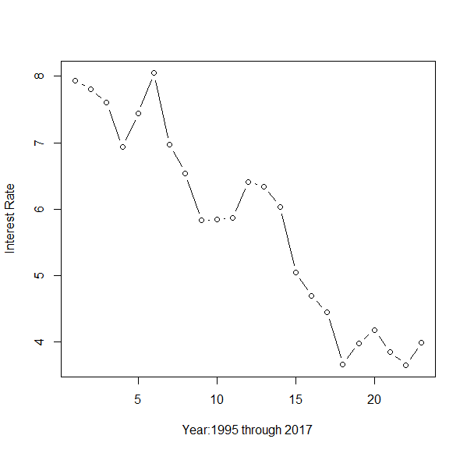
Forecasting: The Regression Approach
Exercise 10.8 (8th edition) Mortgage interest rates Data consist of annual average mortgage interest rates for conventional, fixed-rate, 30-year loans for 1995-2017
Call:
lm(formula = RATE ~ YEAR, data = IntRate_df)
Residuals:
Min 1Q Median 3Q Max
-0.86366 -0.26926 -0.08014 0.15648 1.00148
Coefficients:
Estimate Std. Error t value Pr(>|t|)
(Intercept) 427.85879 29.46600 14.52 2.01e-12 ***
YEAR -0.21041 0.01469 -14.32 2.61e-12 ***
---
Signif. codes: 0 ‘***’ 0.001 ‘**’ 0.01 ‘*’ 0.05 ‘.’ 0.1 ‘ ’ 1
Residual standard error: 0.4673 on 21 degrees of freedom
Multiple R-squared: 0.9072, Adjusted R-squared: 0.9027
F-statistic: 205.2 on 1 and 21 DF, p-value: 2.609e-12

Slide 17
Exercise 10.8 (Continued)
> lmod <- lm(RATE ~ YEAR,data=IntRate_df)
> lmod$fitted[23] #Fit at 2017
23
3.47163
>
> #compute predictions at 2018 and 2019 using typical regression approach
> forecast_y <- data.frame(YEAR=seq(2017,2019,1)) #forecasts for 2017, 2018, 2019.
> predict(lmod,forecast_y, interval="prediction")
fit lwr upr
1 3.471630 2.423636 4.519624
2 3.261225 2.203041 4.319409 FIT AT 2018
3 3.050820 1.981670 4.119970
> forecast_m <- data.frame(YEAR=seq(2018,2019,.25)) #Quarterly Forecasts
> predict(lmod,forecast_m, interval="prediction")
fit lwr upr
1 3.261225 2.203041 4.319409
2 3.208624 2.147770 4.269478
3 3.156023 2.092451 4.219594
4 3.103421 2.037085 4.169758
5 3.050820 1.981670 4.119970
Answer from text

Slide 18
A common way to describe seasonal differences in a time series is with dummy variables. Here is a model that includes both trend and seasonal components:
How to address seasonality in a Regression model?

Slide 19
Exercise 10.11 (8th edition) Graphing calculator sales. (Used SAS)
Obs | year | quarter | sales_index | Q1 | Q2 | Q3 | t
1 | 2014 | 1 | 438 | 1 | 0 | 0 | 1
2 | 2014 | 2 | 398 | 0 | 1 | 0 | 2
3 | 2014 | 3 | 252 | 0 | 0 | 1 | 3
4 | 2014 | 4 | 160 | 0 | 0 | 0 | 4
5 | 2015 | 1 | 464 | 1 | 0 | 0 | 5
6 | 2015 | 2 | 429 | 0 | 1 | 0 | 6
7 | 2015 | 3 | 376 | 0 | 0 | 1 | 7
8 | 2015 | 4 | 216 | 0 | 0 | 0 | 8

Slide 20
Exercise 10.11 (Continued)
Parameter Estimates
Variable | DF | Parameter Estimate | Standard Error | t Value | Pr > |t|
Intercept | 1 | 119.85000 | 16.94951 | 7.07 | <.0001
t | 1 | 16.51250 | 1.02771 | 16.07 | <.0001
Q1 | 1 | 262.33750 | 16.72999 | 15.68 | <.0001
Q2 | 1 | 222.82500 | 16.57140 | 13.45 | <.0001
Q3 | 1 | 105.51250 | 16.47552 | 6.40 | <.0001
t | Year/Quarter | Predicted | 95% Prediction Interval
21 | 2019/1 | 728.95 | 662.80 | 795.10
22 | 2019/2 | 705.95 | 639.80 | 772.10
23 | 2019/3 | 605.15 | 539.00 | 671.30
24 | 2019/4 | 516.15 | 450.00 | 582.30
Two-tailed DW test is not significant. D=1.986
1st order
autocorrelation = -0.182
R_{t}=ɸ R_{t-1} = error_{t}
-1 < ɸ < 1
Answers from text:

Slide 21
Autocorrelation and Autoregressive Error Models
1st order autoregressive model
Stationary time series: the autocorrelation function depends only on the distance m between R values and not on time t.

Slide 22
Simple example: toss a balanced coin every day. The probability distribution does not change over time.

Slide 23


Exercise 10.16 (8th edition)
Suppose the random component of a time series model follows the first-order autoregressive model with varying phi=.9, -.9, .2, -.2. Compute and plot the first 10 autocorrelations
Obs | m | phi
1 | 1 | -0.9
2 | 2 | 0.81
3 | 3 | -0.729
4 | 4 | 0.6561
5 | 5 | -0.59049
6 | 6 | 0.53144
7 | 7 | -0.4783
8 | 8 | 0.43047
9 | 9 | -0.38742
10 | 10 | 0.34868
Obs | m | phi
1 | 1 | -0.2
2 | 2 | 0.04
3 | 3 | -0.008
4 | 4 | 0.0016
5 | 5 | -0.00032
6 | 6 | 0.00006
7 | 7 | -0.00001
8 | 8 | 0
9 | 9 | 0
10 | 10 | 0

Slide 24
Exercise 10.16 Continued

Slide 25
Constructing Time Series Models
The general form of a time series model is:
y_{t} = E(y_{t} ) + R_{t} where
E(y_{t} ) = β₀ + β₁x₁ + β₂x₂ + ··· + β_{k}x_{k}
A time series model basically consists of a pair of models:
one model for the deterministic component E(y_{t} )
one model for the autocorrelated residuals R_{t}
Use our knowledge gained in previous chapters for the deterministic component – also think of trend T_{t}, cyclical C_{t}, and seasonal S_{t} effects.
Some additional considerations:
Some x’s may be time series variables.
Some x’s may be lagged.
Some x’s may be trigonometric functions of time.
Choosing the residual component
ε_{t} is white noise (uncorrelated error)

Slide 26
Consequences from not adjusting model for autocorrelation among the residuals
The OLS regression estimators for B’s are still unbiased but are no longer minimum variance
When errors are positively autocorrelated, residual mean square may seriously underestimate σ². ➔ standard errors of the regression coefficients may be too small ➔ confidence and prediction intervals shorter than they really should be. Tests of hypotheses on individual regression coefficients have increased Type I error rates (greater than alpha levels specified).
Overoptimistic evaluations of a model’s predictive ability.
Successfully modeling the residual autocorrelation can actually lead to smaller MSE and correspondingly narrower prediction intervals.

Slide 27
Exercise 10.21 (7th and 8th editions)

Slide 28
Exercise 10.22 (7th and 8th editions)

Slide 29
Fitting Time Series Models with Autoregressive Errors
From 7th and 8th editions of textbook
We will follow these steps using an example.
Important consideration from authors for Step 3: The simplest autoregressive error model is the first-order autoregressive model
R_{t} = φR_{t}−1 + ε_{t} .Recall that the autocorrelation between residuals at two different points in time diminishes as the distance between the time points increases. Since many business and economic time series exhibit this property, the first-order autoregressive model is a popular choice for the residual component.

Slide 30
SAS code for Ex10_26
data ex10_26;
input YEAR RATE;
time=_n_;
datalines;
1995 7.93
1996 7.81
.
.
.
2016 3.65
2017 3.99
;
run;
ods pdf file="Ex10_26_Output.pdf";
run;
title1 "Exercise 10.26/7th and 8th editions: Steps 1 and 2";
title2 "Obtain initial estimates of the Betas, Conduct DW test";
proc print data=ex10_26;
run;
ods graphics on;
proc reg data=ex10_26;*get the regression estimates;
model RATE=time/dw dwprob;
run;
title1 "Exercise 10.26/7th and 8th editions: Steps 3 and 4";
title2 "There is evidence of autocorrelation. Use 1st order autoregressive model";
proc sgplot data=ex10_26 noautolegend;
series x=time y=RATE / markers;
reg x=time y=RATE/ lineattrs=(color=black);
run;
proc autoreg data=ex10_26;
model RATE = time/nlag=1;
run;
ods close pdf;run;
quit;
See Ex10_26_Output.pdf

Slide 31
Comparison of least squares and time series results
Ex. 10.26 Mortgage interest rates from 1995 through 2017
Measure | Least Squares | Autoregressive
R2 | 0.9072 | 0.9263
MSE | 0.2184 | 0.18191
B0 hat | 8.311 | 8.2552
B1 hat | -0.2104 | -0.2048
Std error(B0 hat) | 0.2014 | 0.2011
Std error(B1 hat) | 0.0147 | 0.0216
t statistic for H0:Beta1=0 | -14.32 | -9.48
p-value | p<0.0001 | p<0.0001
phi hat | Does not apply | 0.4374 | The SAS estimate of phi is defined so that phi takes the opposite sign from the specified model.
t statistic for H0: phi = 0 | Does not apply | 2.18 | (p=0.0414)

Slide 32
Forecasting with Time Series Autoregressive Models
The textbook demonstrates the technique of forecasting for the simple model: Y_{t} = B₀ + B₁x_{t} +R_{t} where R_{t} = ɸR_{t-1} + ε_{t}
Y_{n+1} = B₀ + B₁x_{n+1} + R_{n+1} where R_{n+1} = ɸR_{n} + ε_{n+1} or
Y_{n+1} = B₀ + B₁x_{n+1} + ɸR_{n} + ε_{n+1} so the forecast at n+1 is
F_{n+1} = hat(B₀) + hat(B₁)x_{n+1} + hat(ɸ)R_{n} where ε_{n+1} is set to its expected value of 0 and
the estimates hat() are based on the time series model-fitting approach
and R_{n} is obtained by noting that R_{n} = y_{n} - B₀ + B₁x_{n} so that
hat(R_{n} ) = y_{n} – hat(B₀ ) + hat(B₁) x_{n}
The forecasting of future y-values turns out to be an iterative process, with each new forecast making use of the previous residual to obtain the estimated residual for the future time period.

Slide 35
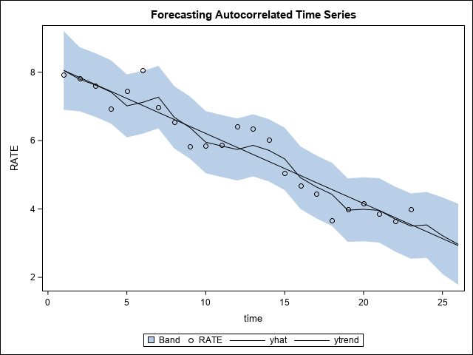
Ex. 10.31 Forecasting with data from Ex. 10.26

Slide 36
Seasonal time series model – an example
Exercise 10.35 8th edition/10.38 7th edition – Hotel room occupancy rates
A traditional indicator of the economic health of the accommodations (hotel/motel) industry is the trend in room occupancy. Average monthly occupancies for 2 recent years are provided for hotels and motels in the cities of Atlanta and Phoenix.
See Ex 10_35_Output.pdf for analysis.
Note: For Phoenix, the least squares model has an R2 of 0.9752 and the auto-regressive model has an R2 of 0.9756. Use of the auto-regressive model for forecasting is questionable.

